Slide 1
CHAPTER 17
Fatty Acid Catabolism
Xiao-Wei Chen, Ph.D.
xiaowei_chen@pku.edu.cn

Slide 2
Outline of today’s lecture
Principles of fatty acid catabolism
Other types of fatty acid catabolism
Ketogenesis and diabetic ketoacidosis

Slide 3
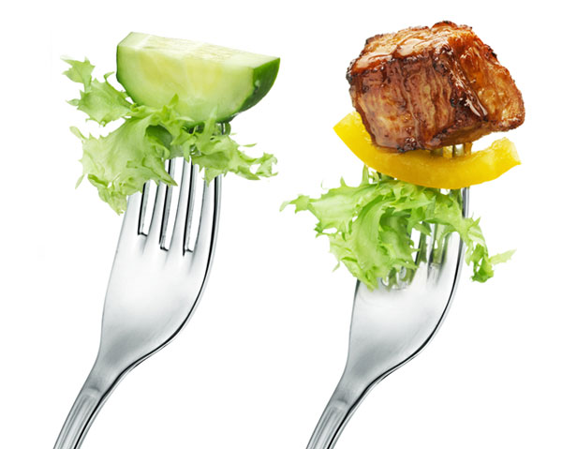
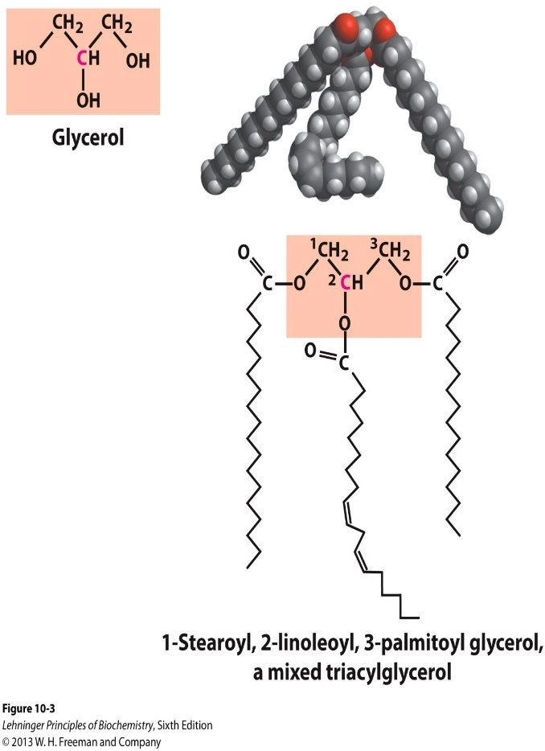
Meat or Veggie, that’s the question

Slide 4
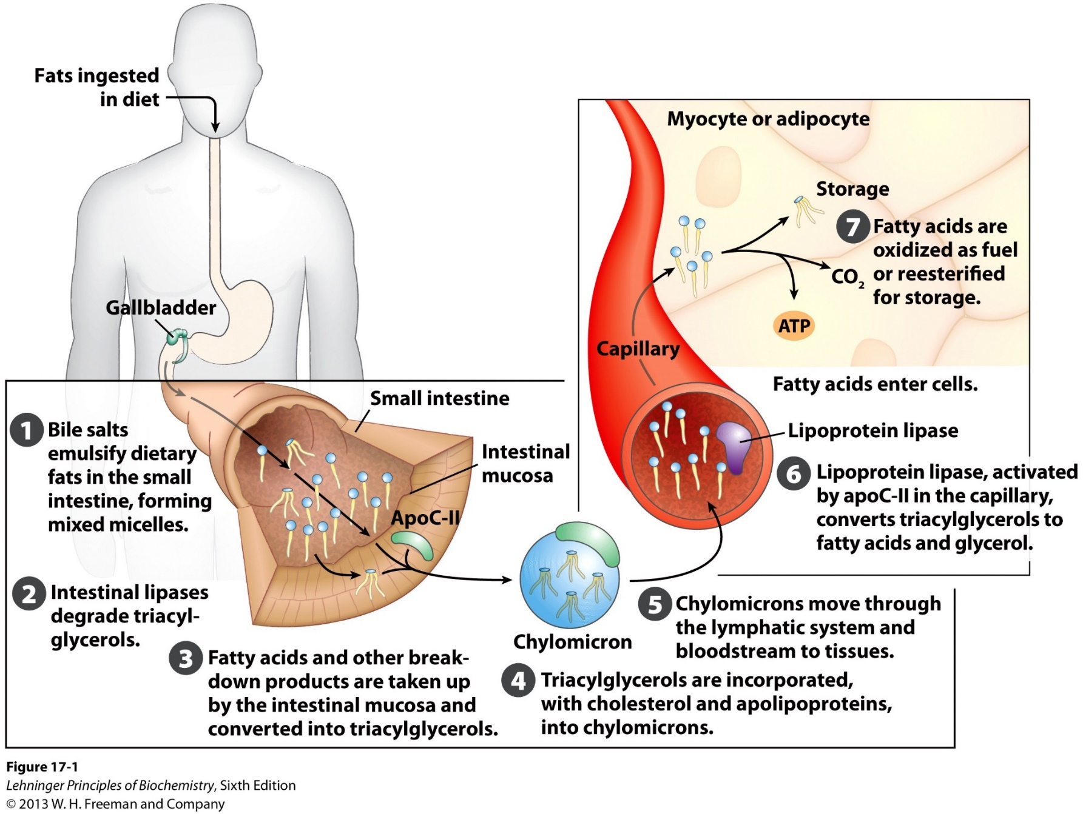
Absorption and transport of dietary lipids
Natural detergent

Slide 5
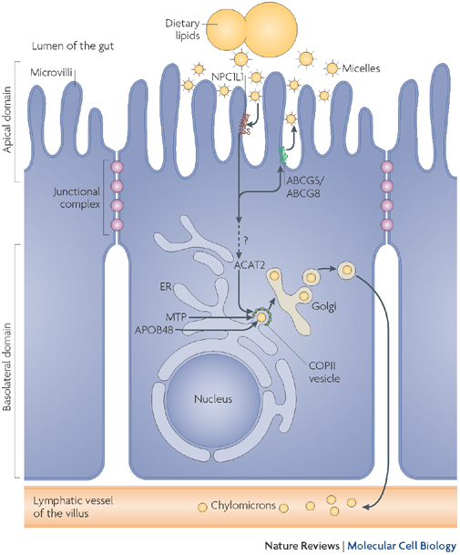
Absorption and transport of dietary lipids
in enterocytes (small intestine)
Cycle between TAG and FFA
Breakdown into free fatty acids
Uptake of free fatty acids
Covert back to triglycerides
Package into lipid carriers

Slide 6
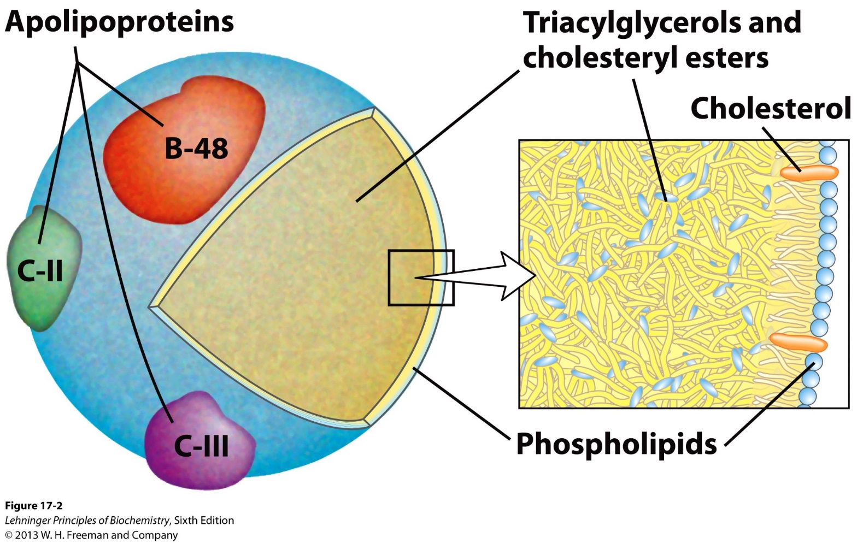
Lipoproteins (lipid + proteins) as lipid carriers
Apolipoproteins: structural components, amphipathic
Neutral lipids form core
Monolayer of phospholipids forms surface.

Slide 7
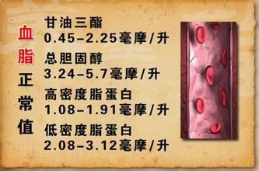
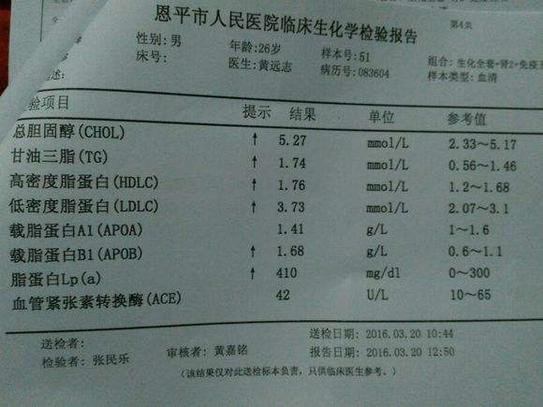
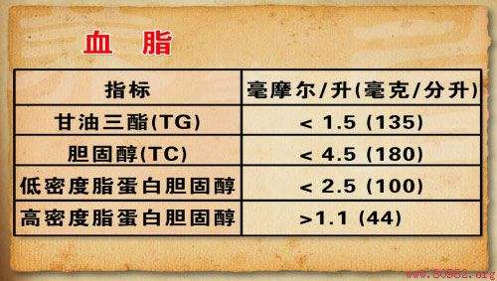
A real life experience with blood lipids

Slide 8
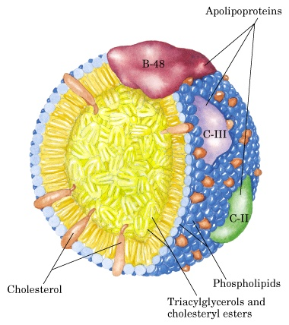
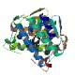
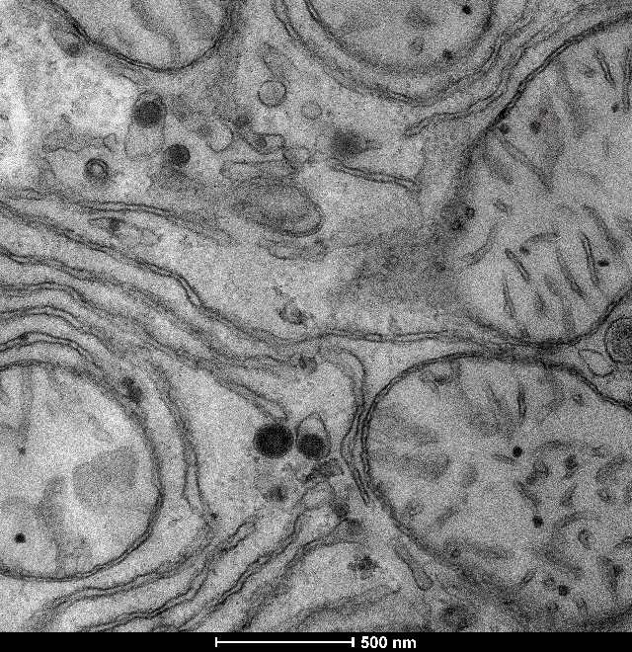
Lipoproteins (lipid + proteins) as lipid carriers
under lab investigation
Apolipoproteins
Secretory proteins
~10Å
~800-10,000Å
ER
Phospholipids
Cholesterol
Neutral Lipids

Slide 9
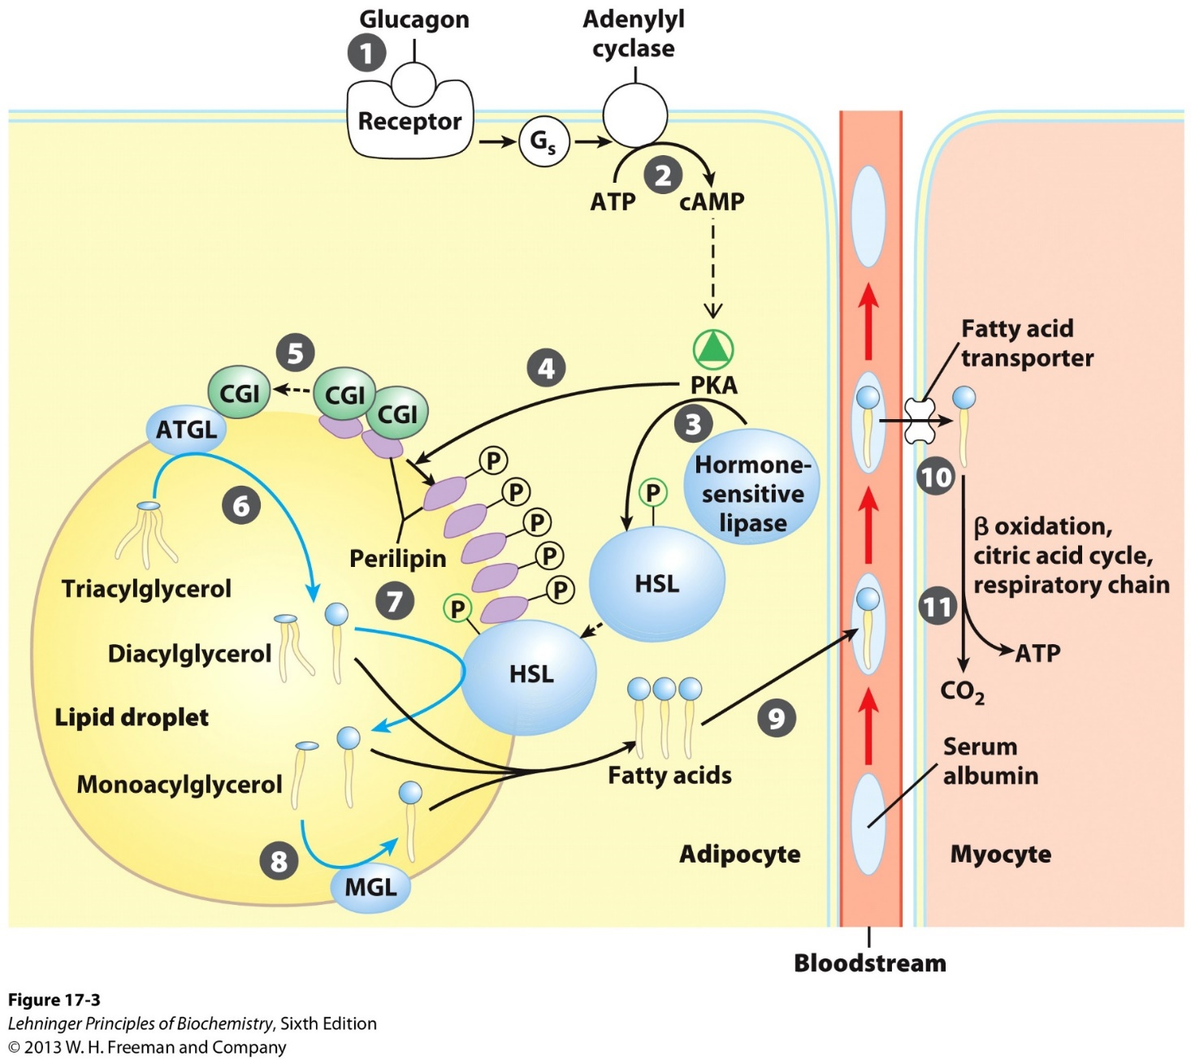
Mobilization of TAG in cells: hydrolysis into glycerol and free fatty acids (FFA)

Slide 10
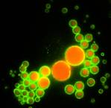
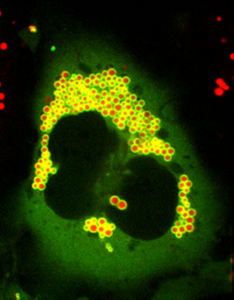
Lipolysis of TAG into glycerol and free fatty acids (FFA)
Activation of lipase (often by hormonal/metabolic signals)
Hydrolysis of TAG stored in lipid droplets
Release of glycerol and FFAs
FFAs bound with Albumin are delivered to other tissues.
Lipolysis

Slide 11
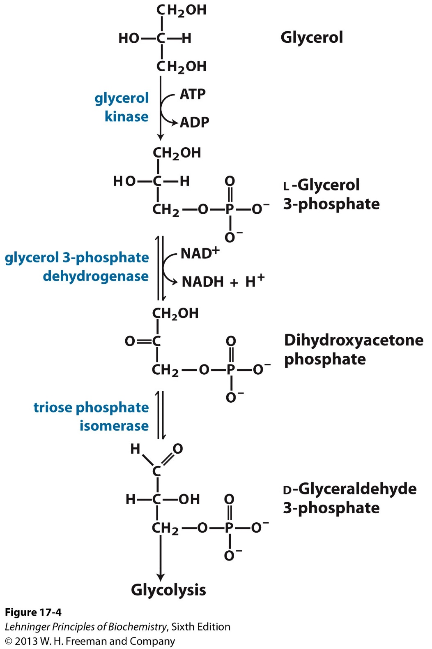
Catabolism of glycerol and free fatty acids (FFA)
Glycerol can be fed into glycolysis
FFA oxidation (yield most energy)
takes place in mitochondrion matrix
Activation of FFA in the cytosol
Transport into the Mito matrix
Oxidation into Acetyl-CoA

Slide 12
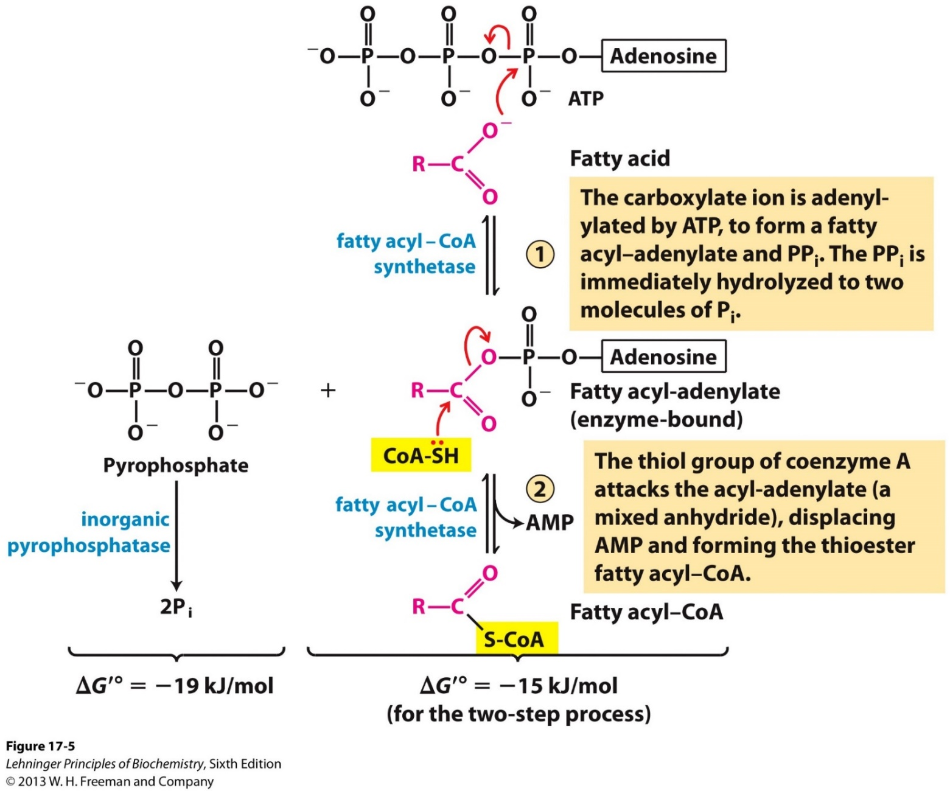
Step 1. Activation of FFA: generation of acyl-CoA by fatty acyl-CoA synthetase
Overall reaction

Slide 13
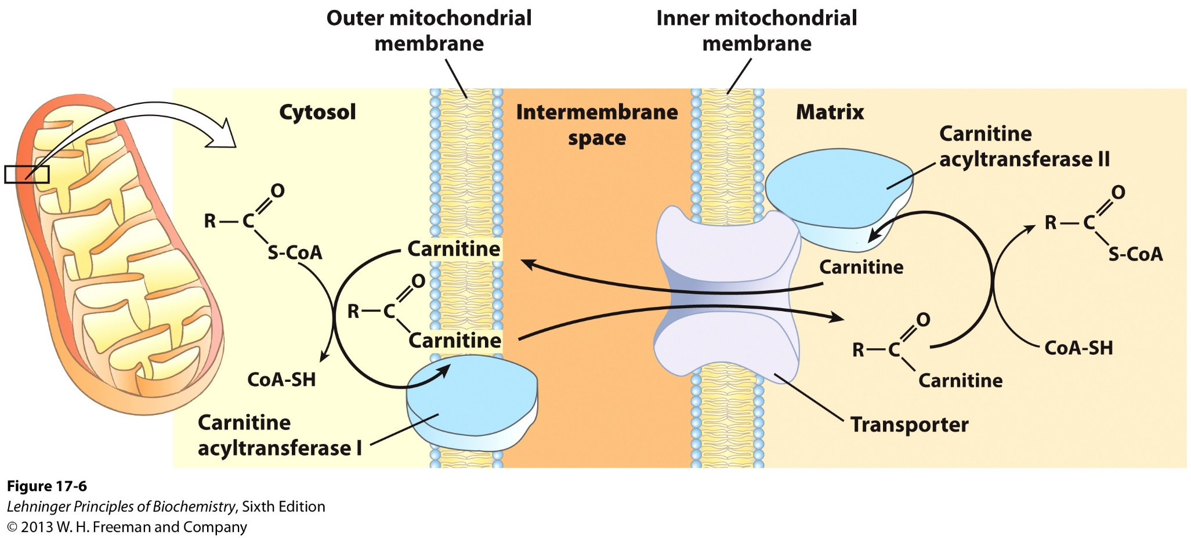
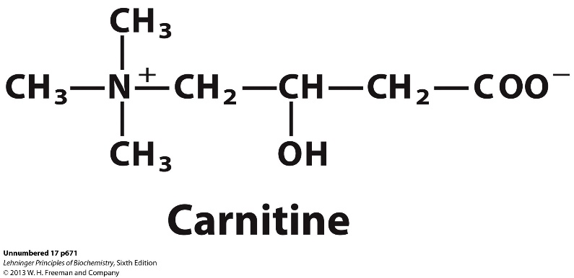
Step 2. Transport of acyl-CoA into the mitochondria matrix

Slide 14
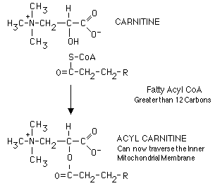
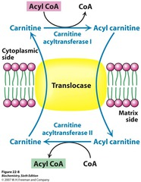
Step 2. Transport of acyl-CoA into the mitochondria matrix
CACT: Carnitine Acylcarnitine
Translocase

Slide 15
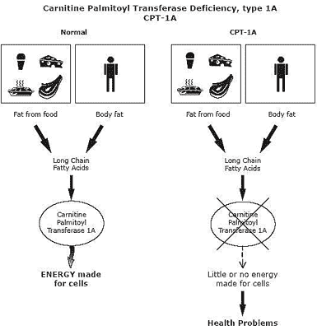
Step 2. Transport of acyl-CoA into the mitochondria matrix
X

Slide 16
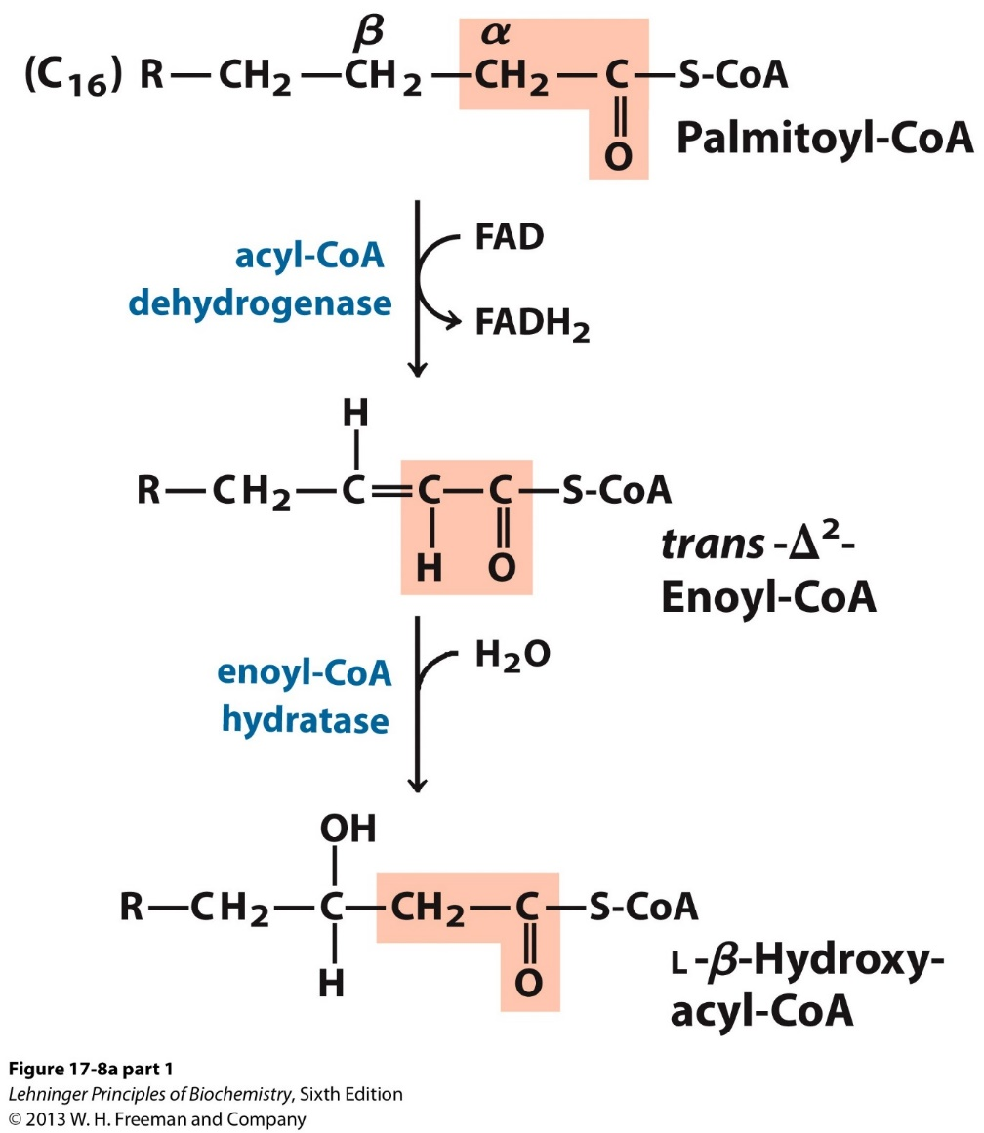
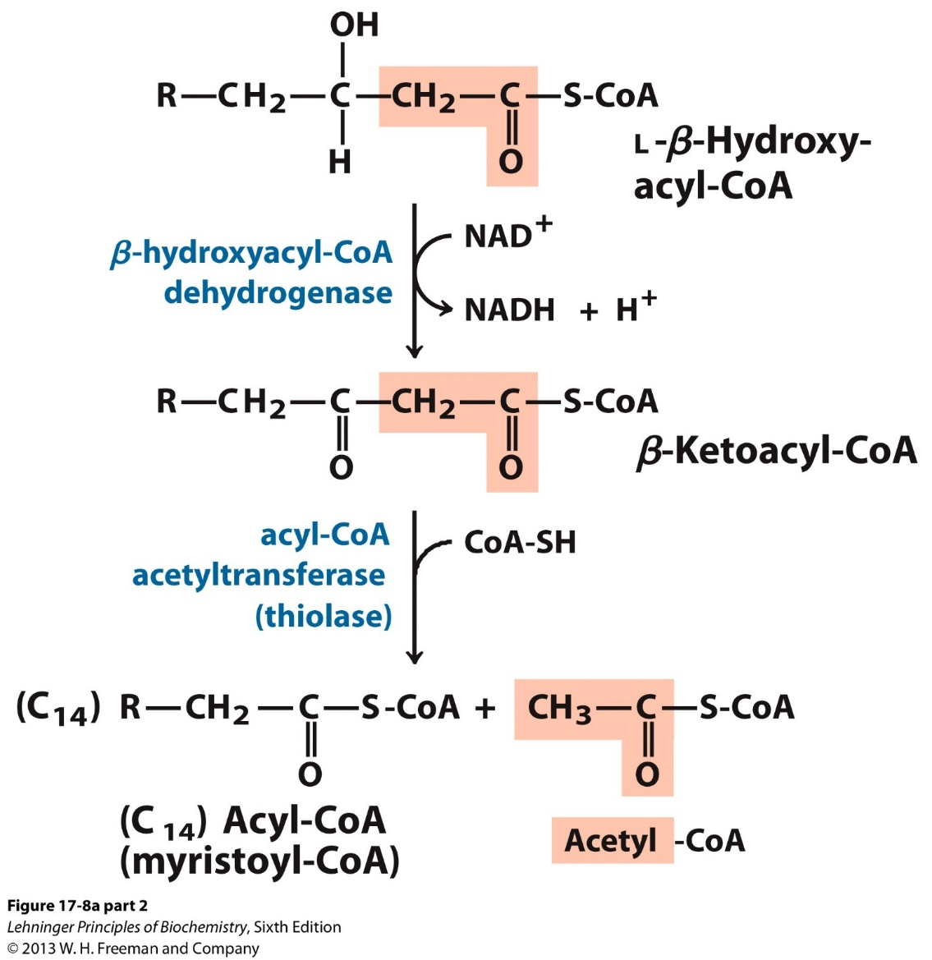
Step 3. The four reactions of one round of β oxidation of saturated fatty acids

Slide 17
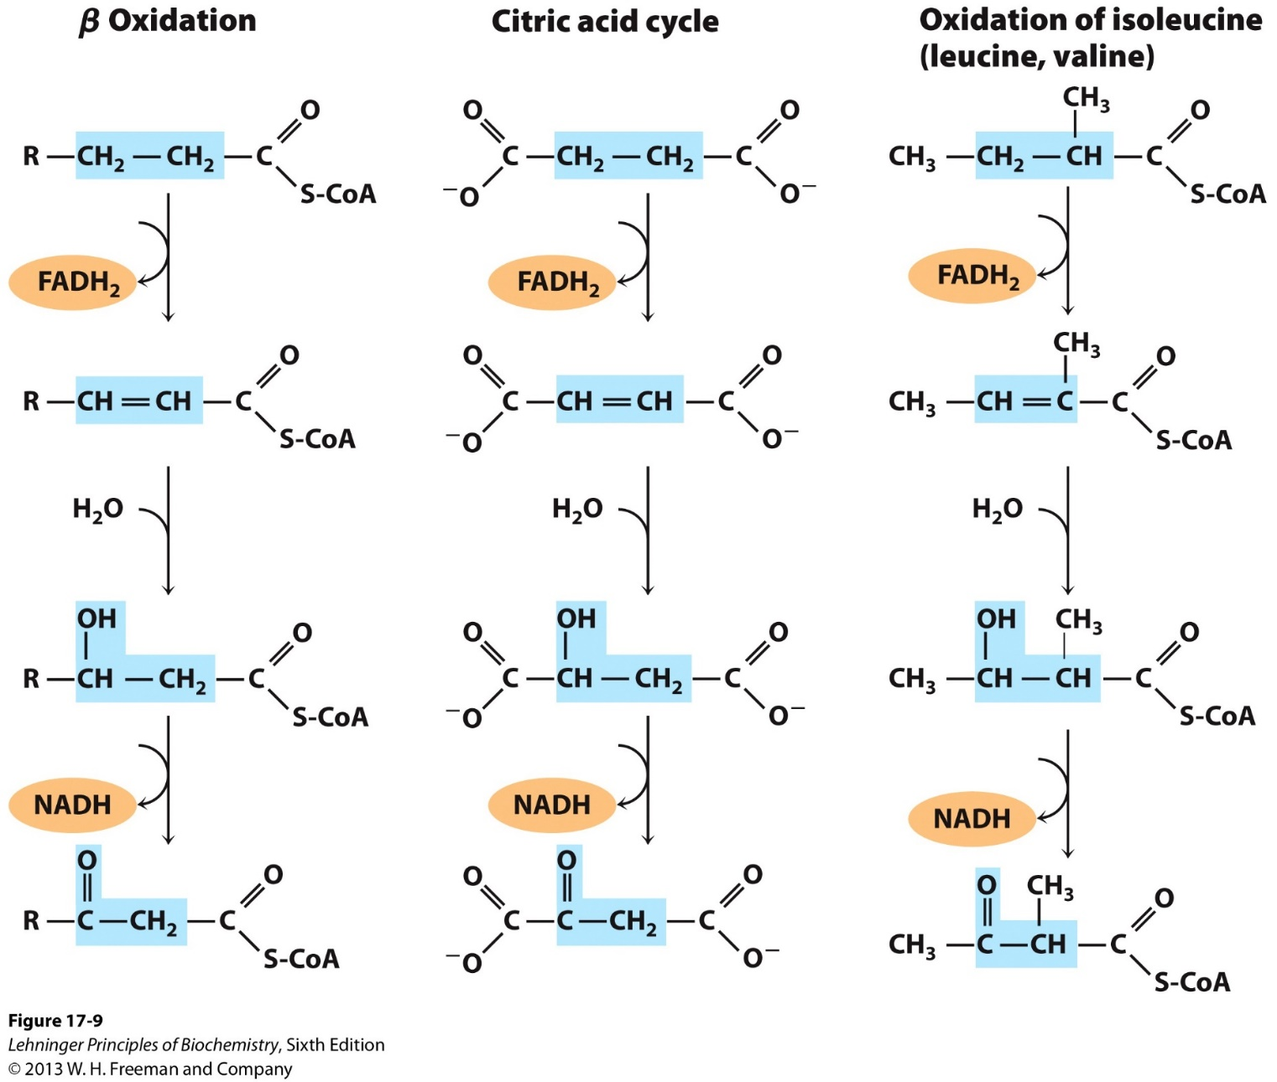
A conserved reaction sequence for “β oxidation”
ETF
Electron transfer flavoprotein
ETC
O₂

Slide 18
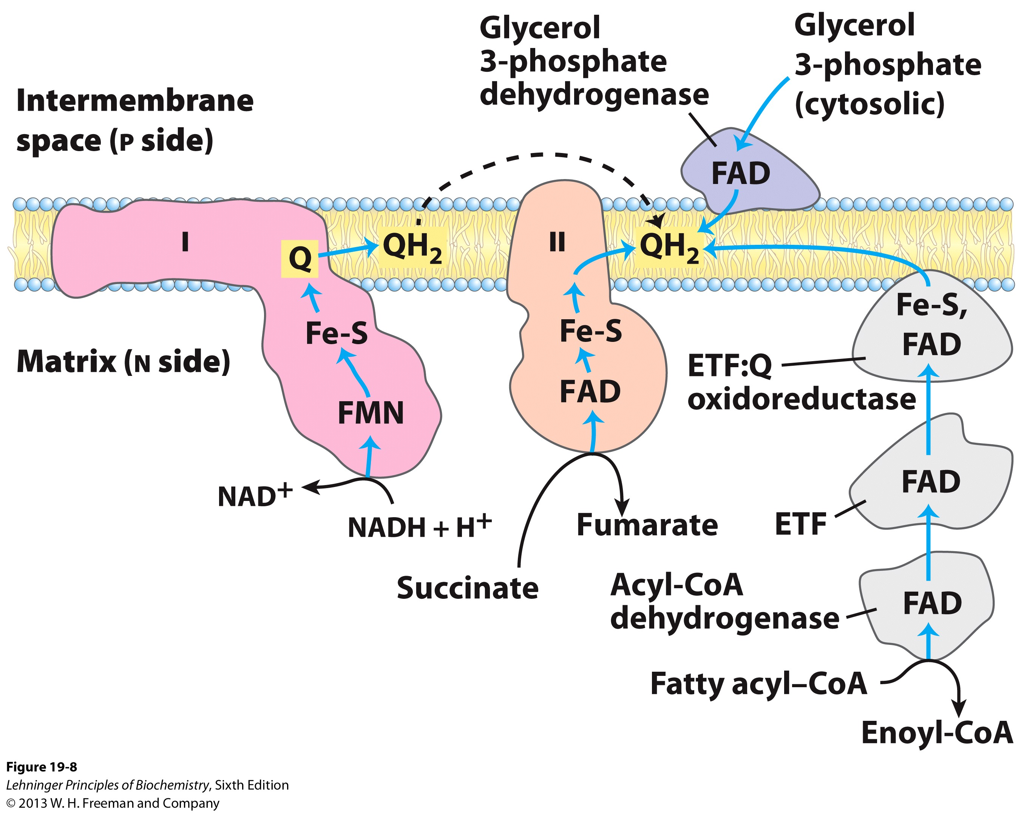
Different path of electron flow from NADH, succinate, and Acyl-CoA

Slide 19
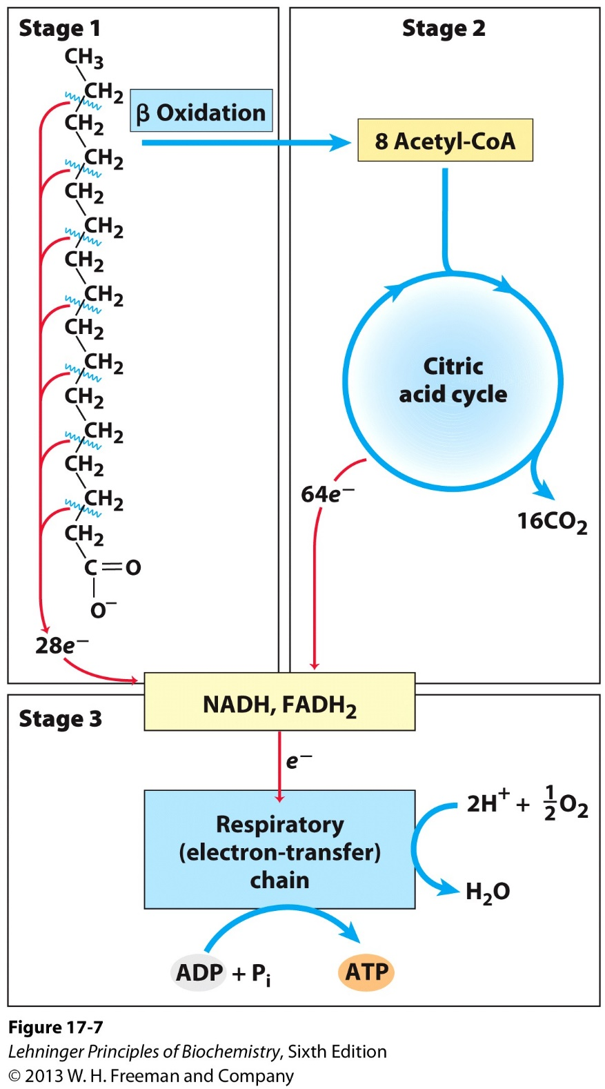
Yield of fatty acid oxidation
Palmitoyl-CoA: C16, fully saturated
8 acetyl-CoA
7 FADH₂
7 NADH

Slide 20
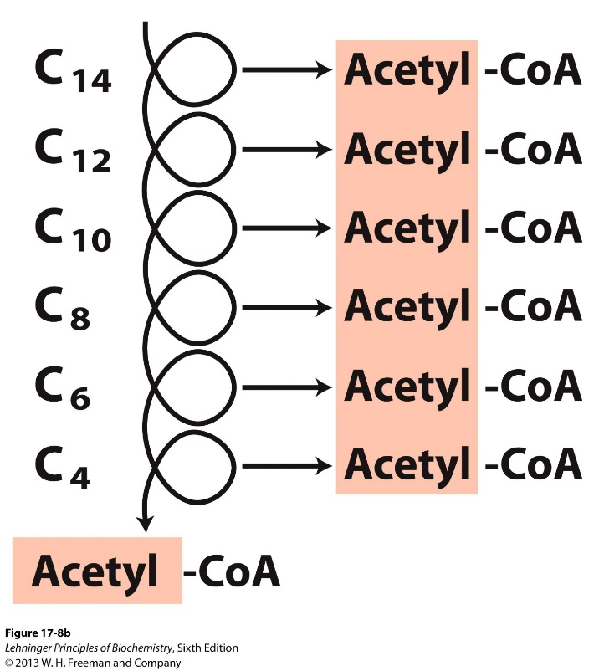
Oxidation of even number fatty acids
Very Long Chain Acyl-CoA Dehydrogenase
(VLCAD): 12– 18 Carbons
Medium Chain Acyl-CoA Dehydrogenase
(MCAD): 4-14 Carbons
Short Chain Acryl-CoA Dehydrogenase
(SCAD): 4-8 Carbons

Slide 21
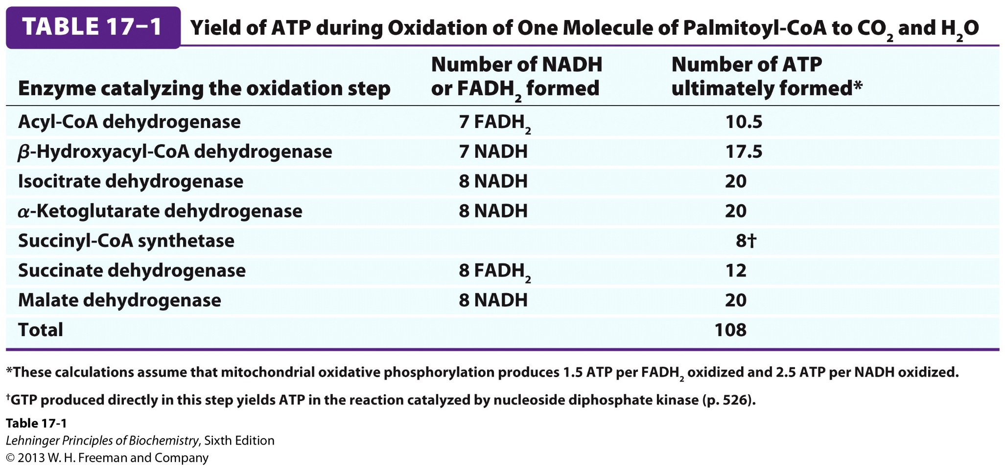
ATP yield of Palmitoyl-CoA oxidation
What about Palmitic acid? 106, why?
AMP + ATP 2ADP

Slide 22
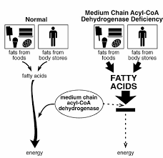
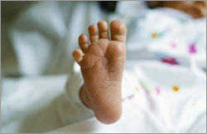
Medium Chain Acyl-CoA Dehydrogenase Deficiency (MCADD): a mitochondrion fatty acid oxidation disease
Intellectual development defects, 25% death rate
New born screen (Methods?)
Treatments? Why?

Slide 23
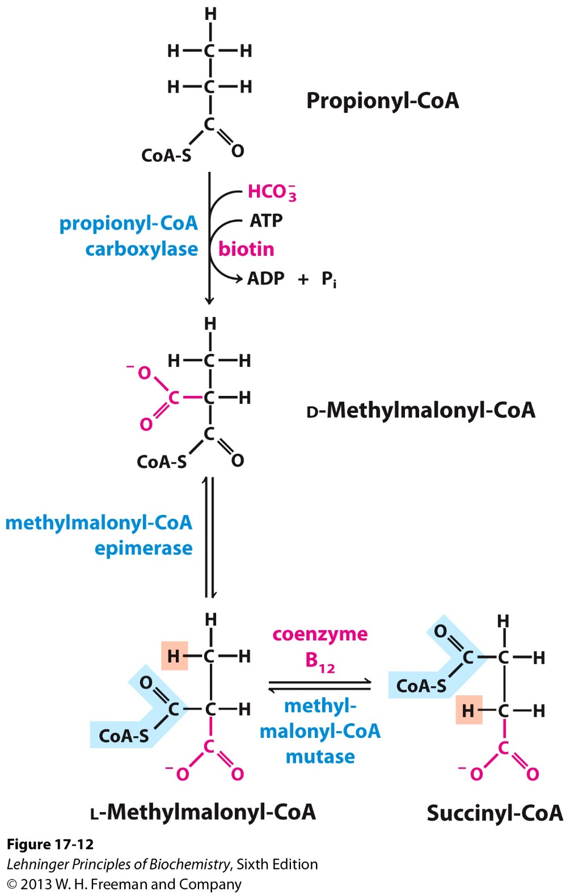
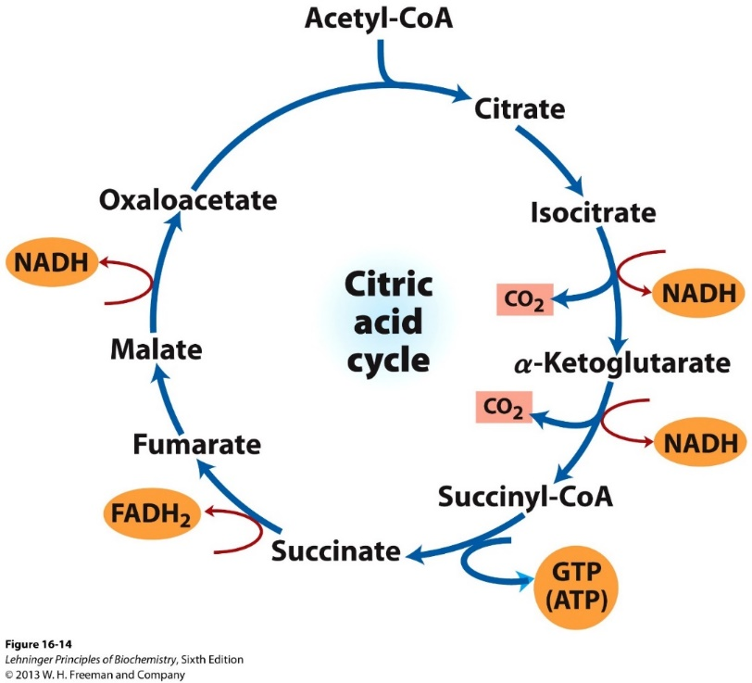
Complete oxidation of odd number fatty acids require 3 additional steps

Slide 24
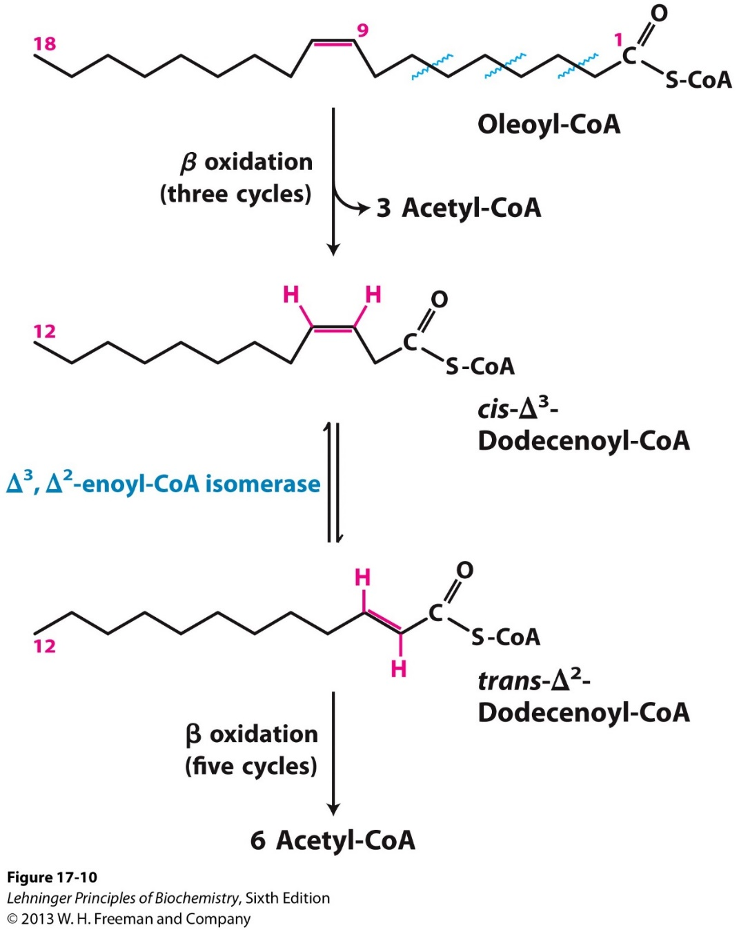
Oxidation of mono-unsaturated fatty acids

Slide 25
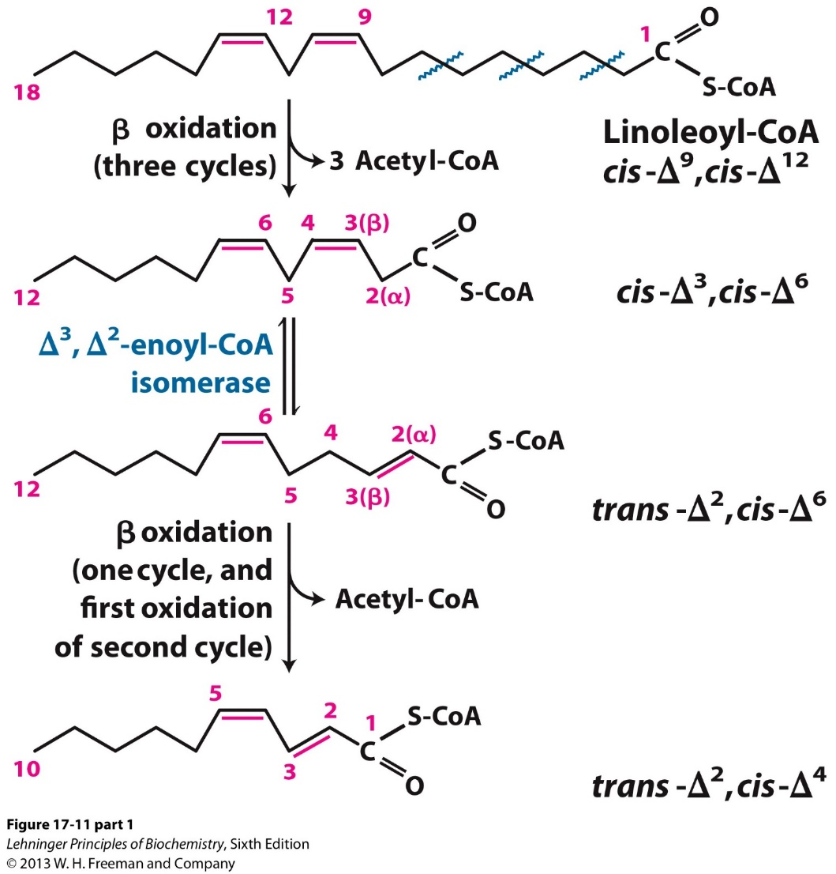
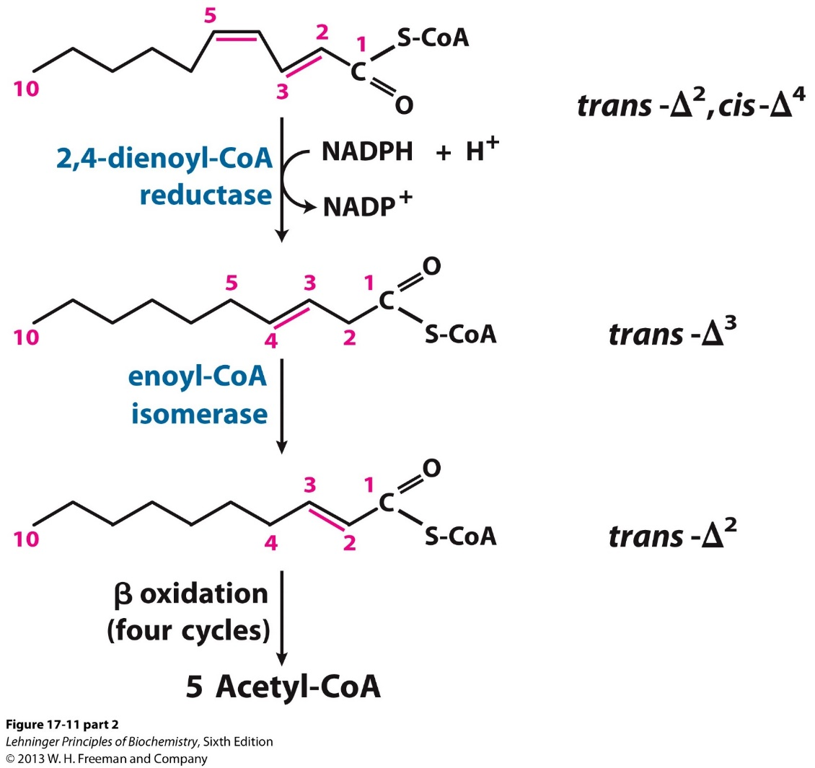
Oxidation of poly-unsaturated fatty acids

Slide 26
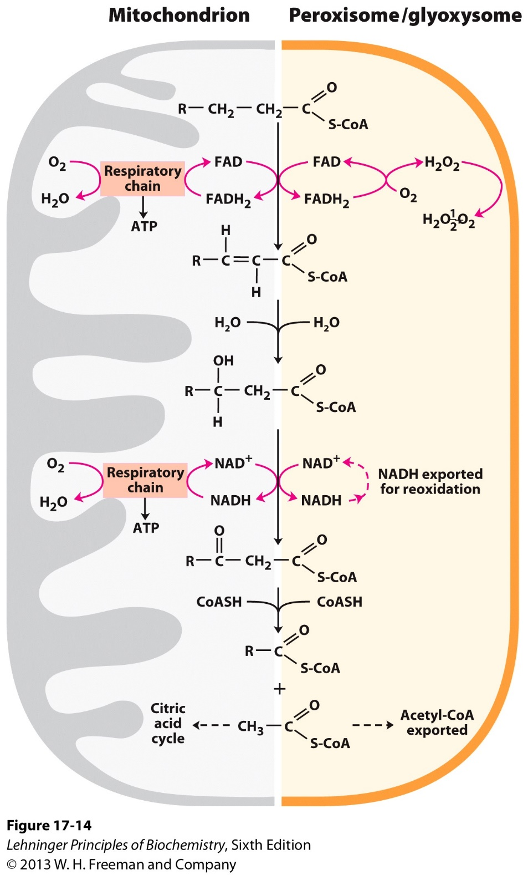
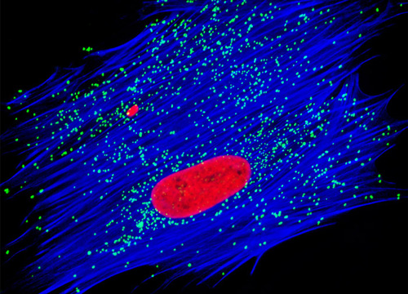
Peroxisome also carries out β Oxidation

Slide 27
Three major differences between mitochondrion β oxidation and peroxisome β oxidation
 | Mitochondrion | Peroxisome
Substrate specificity | Long chain, medium chain, short chain free fatty acids | Very long chain (e.g C26) and branched free fatty acids
First step reaction | Electrons enter the ETC to produce ATP | Electrons directly transferred to oxygen, produces H₂O₂, eventually heat.
Fate of the products | Acetyl-CoA enters the TCA cycle directly | Acetyl-CoA or short chain acyl-CoA exported to the cytosol
Branched fatty acids (e.g. Phytanic acids) undergo α oxidation in the peroxisome.

Slide 28
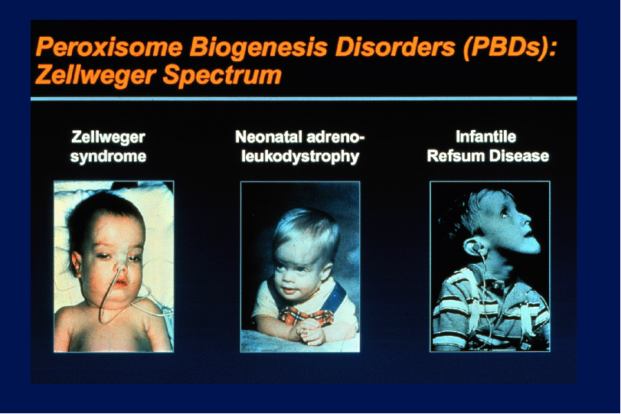
新生儿肾上腺脑白质营养不良
Refsum disease: a genetic defect in phytanoyl-CoA hydroxylase (α oxidation), leading to very high blood levels of phytanic acid and severe neurological problems including blindness and deafness.

Slide 29
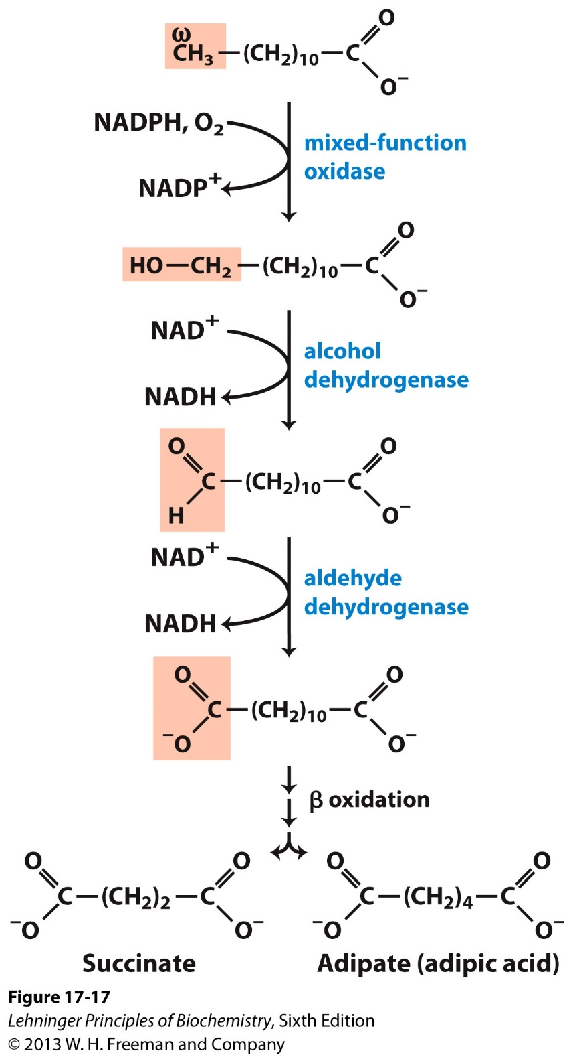
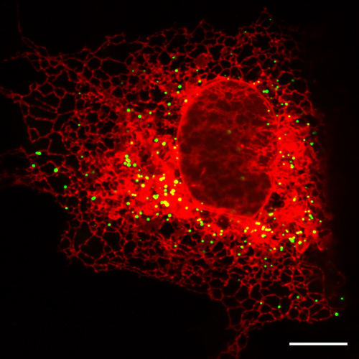
Endoplasmic reticulum carries out ω Oxidation
A minor pathway, compensating β oxidation.

Slide 30
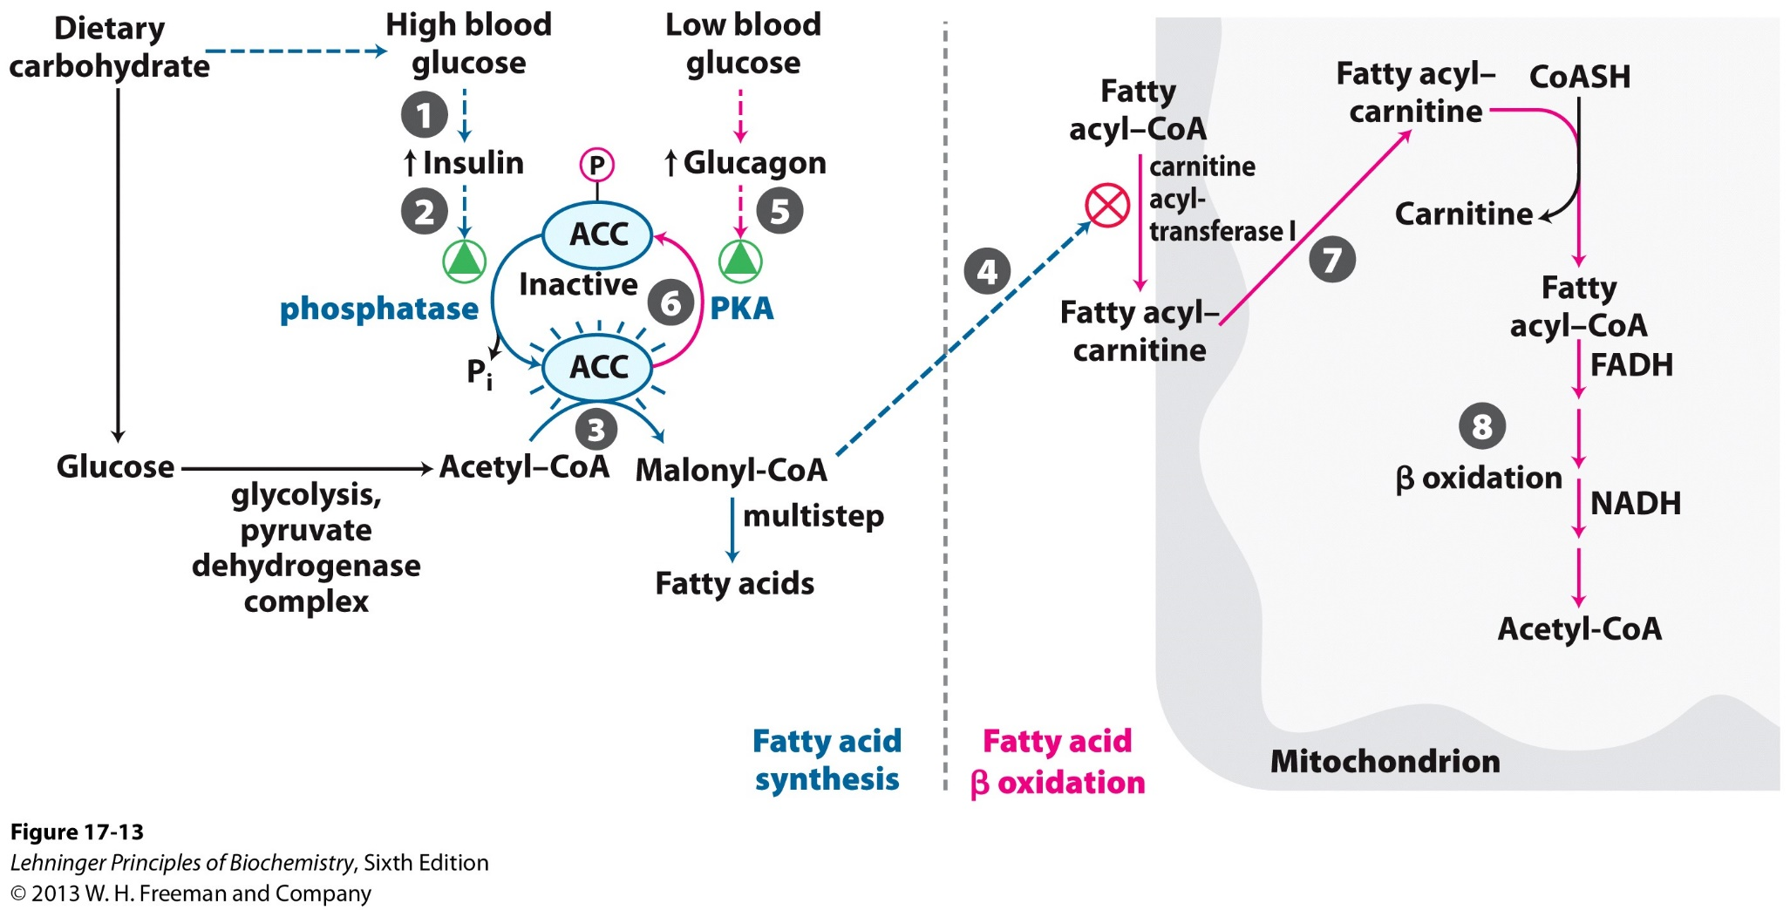
Regulation of fatty acid catabolism
Caffeine's effects on fat?
Fatty acid synthesis and breakdown is tightly coordinated.
Malonyl-CoA inhibits carnitine acyl-transferase I.

Slide 31
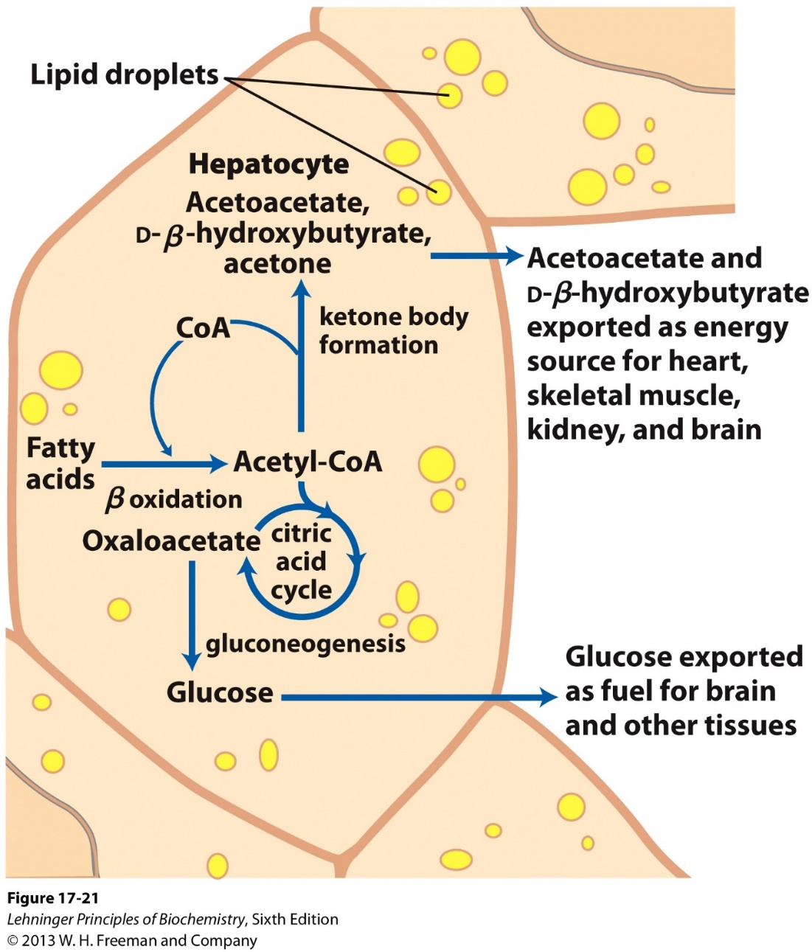
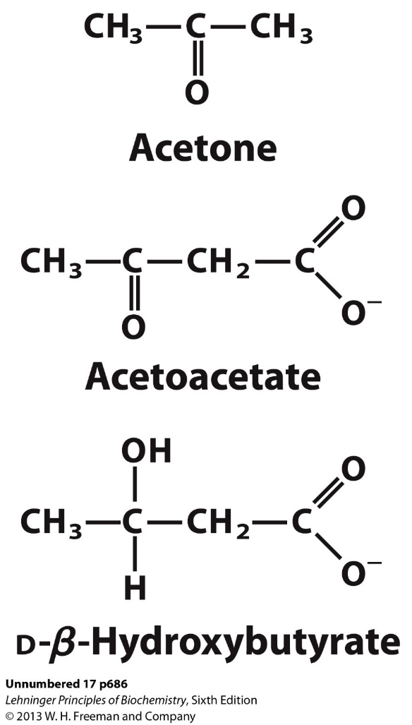
Ketones formed in the liver are delivered to other tissues as alternative fuel sources.

Slide 32
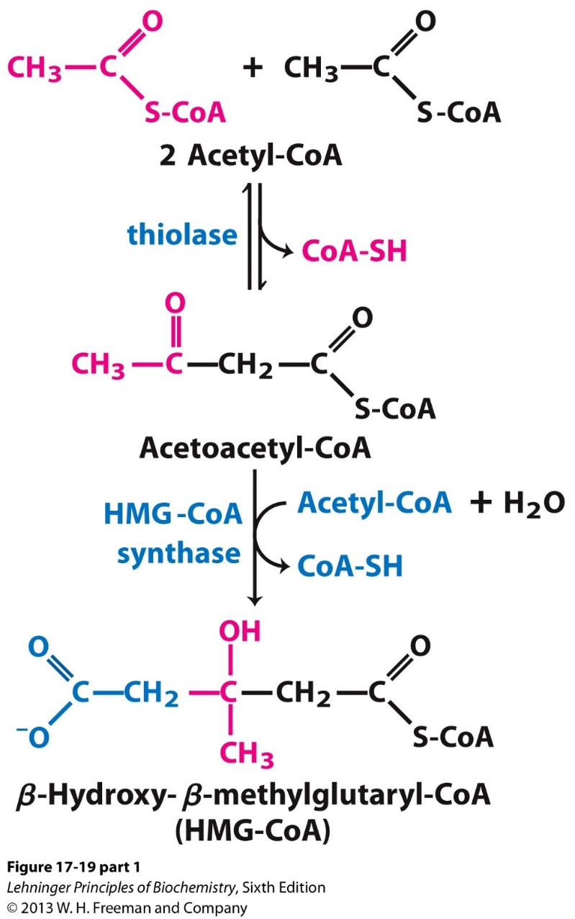
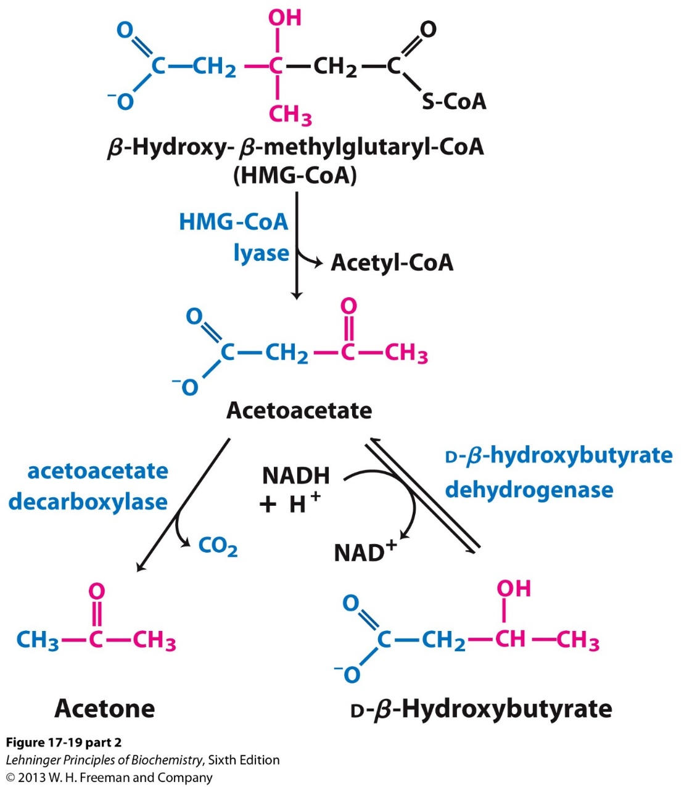
Ketogenesis from acetyl-CoA
1
3
4
2

Slide 33
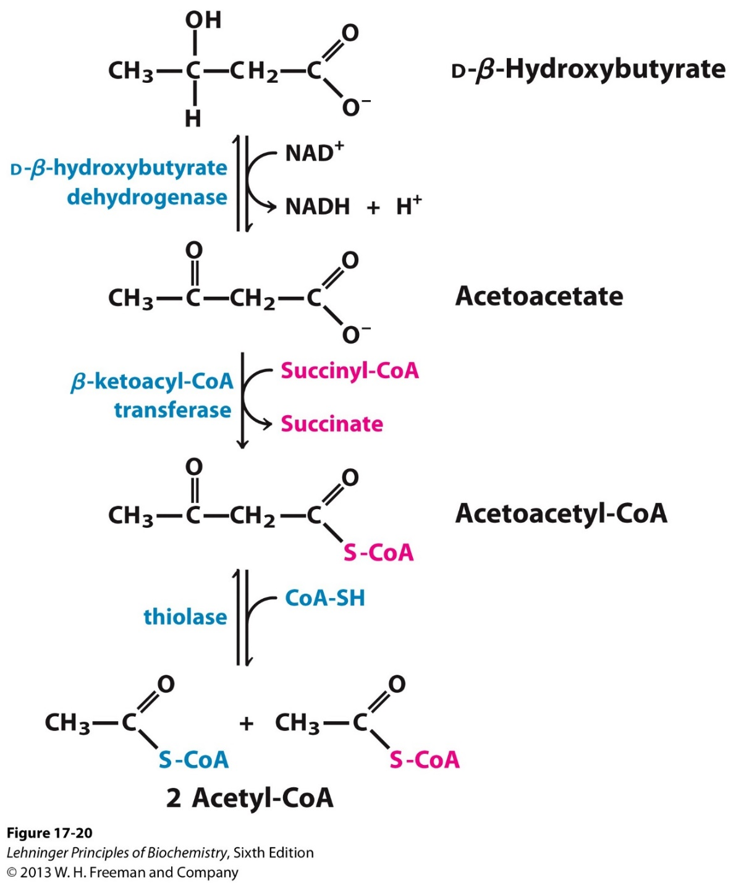
Oxidation of ketones by extrahepatic tissues
A mechanism of delivering acetyl-CoA
When glucose is limited as the fuel source.

Slide 34
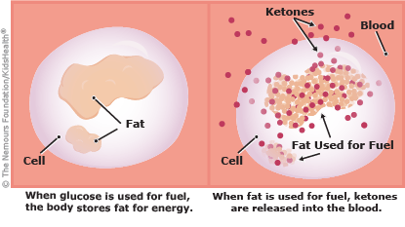
Difference between glucose or fat as fuel sources

Slide 35
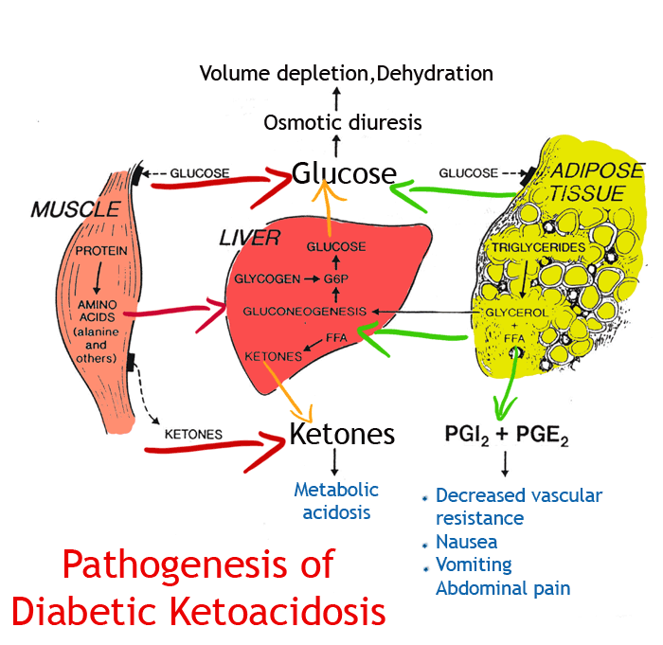
Diabetic ketoacidosis: high level of acidic ketones in the circulation

Slide 36
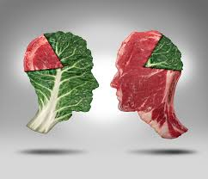
Meat or Veggie, what’s your choice?

